Slide 1


MINOR PROJECT
Integrated Logistics and Multi-Channel Inventory Management Software
ILaMCIMS
MADE BY:
RUDRA KHANDELWAL
B.VOC SOFTWARE DEVELOPMENT
20222770
-
22020107043

Slide 2

Introduction and Objective
ILaMCIMS
is a Python and PostgreSQL-Based Solution designed to streamline logistics and inventory management for businesses operating across multiple sales channels like Amazon, Flipkart, and Meesho. This software will simplifies tasks such as inventory tracking, real-time delivery monitoring, and automated returns processing.
The project is being developed incrementally, with each phase focusing on a specific feature set or technical foundation.
Objectives:
Centralized Inventory Management: Manage inventory levels across multiple channels from a single platform.
Real-Time Tracking (Planned): Monitor live delivery progress, giving customers the ability to track their orders in real-time.
Inventory Forecasting (Planned): Utilize basic machine learning to analyze sales trends and recommend which products are in high demand or declining in popularity.
Automated Returns Processing (Planned): Streamline and automate the process of handling returns, ensuring quick and efficient resolution.
Sales and Purchase Reports (Planned): Generate detailed analytics for business insights.

Slide 3


Scope of the Project
ILaMCIMS aims to address the following:
Optimize inventory handling for businesses with a single supplier and multiple sales channels.
Provide tools for real-time order and delivery tracking.
Automate inventory forecasting to help businesses make data-driven decisions.
Simplify returns processing to enhance customer satisfaction.
Enable seamless integration with third-party e-commerce platforms.
Future Scope and Enhancements
Planned Features
Real-Time Tracking System
Integration with Google Maps API to enable live tracking of delivery personnel.
Display real-time updates for order delivery status on the frontend.
Inventory Forecasting
Implementation of machine learning models to predict inventory demands based on historical data.
Helps optimize stock levels and reduce overstocking or shortages.
Multi-Channel Integration
Seamless synchronization with multiple sales platforms such as Amazon, Flipkart, and Meesho.
Centralized management of inventory and orders across channels.
Automated Returns Processing
Streamlined system for handling customer returns efficiently.
Automated refund initiation and restocking processes.
Real-Time Stock Synchronization
Continuous synchronization between physical and digital stock levels to avoid discrepancies.
Updates across all integrated sales platforms in real-time.
User Authentication and Security
Secure login systems with role-based access for different user types (Admin, Manager, Staff).
Enhanced data protection to maintain confidentiality and integrity.

Slide 4

Project Summary
This project is designed to develop an Inventory Management System through 20 distinct stages, focusing on both learning and implementation. Each phase builds upon the previous one to achieve a scalable and feature-rich solution.
Phases Overview:
Completed Phases
Phase 1: Define Project Scope and Requirements
Phase 2: Set Up Development Environment
Learning: Version control, IDE setup, and project structuring.
Practice: Initialized Git repository and structured folders: models, routes, scripts, etc.
Phase 3: Database Design (SQL)
Phase 4: Build the Database (PostgreSQL) - Supabase
Phase 5: Backend Development - Basic API in FastAPI
Current Progress:
Phase 6: Frontend development underway, focusing on the core UI for inventory management.
Future Phases (7–20):
Includes real-time tracking, inventory forecasting, multi-channel integration, and deployment.
This phased approach ensures a deep understanding of each component while steadily advancing toward the final deliverable.

Slide 5
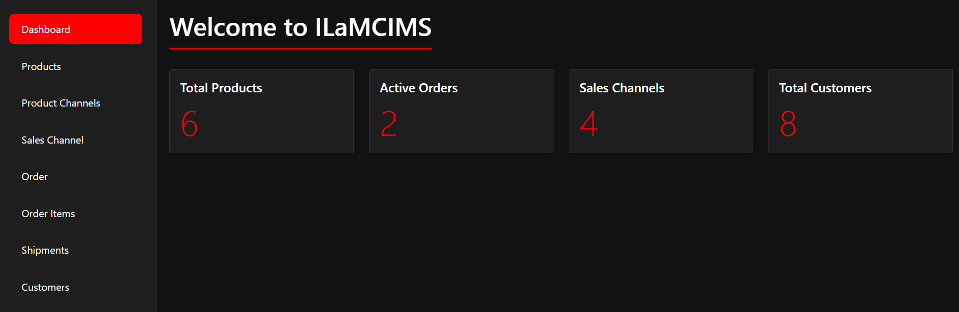
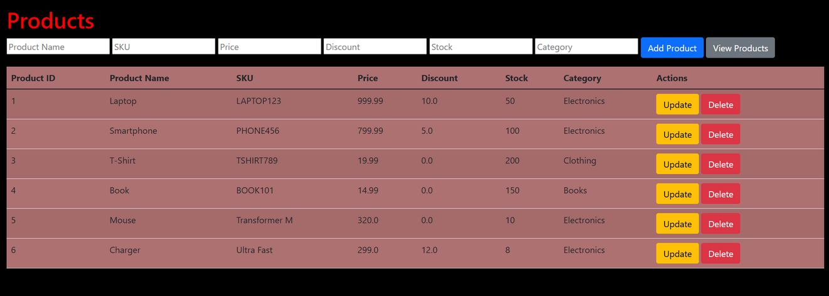
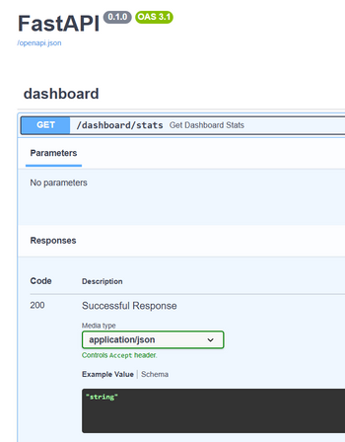
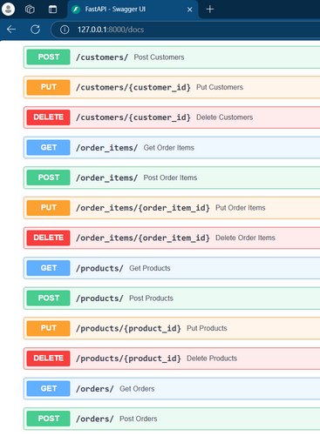
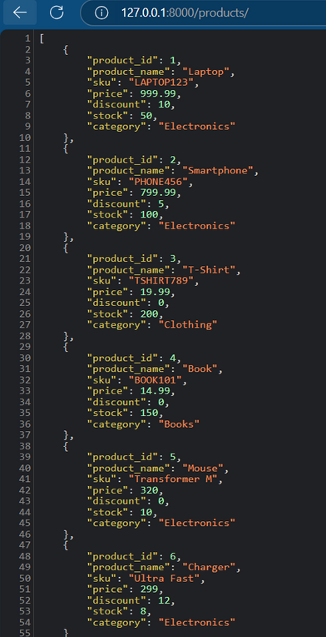
Fontend and Backened

Slide 6








Tools and Technologies
Tool/Technology | Purpose
Python | Backend development, logic implementation, and integration with the database.
PostgreSQL (Supabase) | Database management for storing and retrieving project data securely and efficiently.
FastAPI | Creating RESTful APIs for communication between the frontend and backend.
HTML | Structuring the frontend pages of the system.
CSS | Styling the frontend with a dark theme and responsive design.
JavaScript | Adding interactivity and dynamic behavior to frontend elements.
Bootstrap | Ensuring a responsive and visually appealing design for the UI components.
Supabase | A managed backend-as-a-service (BaaS) providing a cloud-based PostgreSQL database and integration with FastAPI.
Uvicorn | ASGI server for running the FastAPI application during development.
VS Code | IDE for coding, debugging, and version control.
GitHub | Version control system for managing the project's codebase and collaboration.
dotenv | Managing sensitive configuration data (e.g., Supabase credentials) securely using environment variables.
Click here for Project Link ->

